Slide 1
Requirement Analysis Technique Guide
VS SW Process Unit
LG Electronics Inc.

Slide 2
Document Info
Document Information
Issuing authority | VS SW Process Unit
Configuration ID | NA
Status of document | In Progress / Approved / Released
Revision History
Version | Date | Comment | Author | Approver
1.0 | 2016-08-30 | Initial Release | EPG | VC Dev. Engineering FD
1.1 | 2019-02-12 | Update due to annual organization restructuring (VC --> VS) | VS SW Process Unit | VS SW Process Unit leader
1.2 | 2019-08-26 | Update SRS template v2.0 and update according to ASPICE review opinion P.5: Addition of ‘9) Impact assessment on operating environment’ Page 7 : ‘System rq. vs SW rq.’ content added P18: Addition of ‘usability, security, portability ’3.7: Addition of ‘Application Criteria for Requirement Attributes’ Addition of ‘3.9 Assessment of Impact on Operating Environment’ (for ASPICE) ‘#Ref.2. Addition of ‘Use case analysis method’ | VS SW Process Unit | VS SW Process Unit leader
1.3 | 2020-07-06 | Delete document security level footer (LGE Confidential) | VS SW Process Unit | VS SW Process Unit leader

Slide 3
Contents
Requirements Definition Overview
Requirement Definition Approach
Requirement Definition Details 1) System/Software Scope Definition 2) Functional Requirements Definition 3) Interface Requirements Definition 4) Safety Requirements Definition 5) Quality Attribute Definition 6) Constraints, Laws and Standards Definition 7) Requirement Structure and Refinement 8) Requirements verification
9) Evaluate the impact on the operating environment
#Reference1. Criteria for writing Verification Criteria
#Reference2. How to analyze use cases

Slide 4
1. Requirements Definition Overview
The purpose of the requirements definition activity and the requirements items to be specified are as follows.
[For the purpose of defining requirements]
System Requirements Definition: The purpose is to define the technical requirements to be used for system design from customer requirements.
Software Requirements Definition: The purpose of defining the technical requirements to be used for software design/implementation for the items allocated as software among the system requirements.
[Requirement specification item]
The requirements specification items are as follows.
1) Functional Requirements
- A function or action that the system/software must perform to accomplish a given task.
2) Interface Requirements
- How the system/software interacts with related external systems, and defines input/output with external systems, physical means, etc
3) Safety Requirements
- Measures to prevent or reduce risks that may occur due to malfunction of system/software functions
4) Quality Attributes
- Quality requirements to be met by the system/software
5) Constraints, Standards, Regulations
- Conditions, related standards and laws that must be observed to perform system/software design, implementation, and verification

Slide 5
2. Requirement Definition Approach
Requirements definition is performed according to the following approach.
Define system/software scope
Defines the boundaries of the target system/software, and identifies external objects with which it interacts, such as people, systems, and environments.
It defines the input/output contents and means of interacting with the target system/software and external objects.
Define the role of the target system/software.
function definition
Analyze the operating mode and transition conditions of the system/software.
Analyze major operating scenarios by operating mode.
Define the functional requirements of the system/software based on the operating mode and operating scenario.
Define interface requirements
Defines input/output information and means for interface with external system.
If applicable, a detailed specification of the communication protocol should be provided.
If applicable, provide detailed specifications for complex user interfaces.
Define safety requirements
Derive a safety mechanism to be implemented by the system/software.
Describe the safety requirements based on the derived safety mechanism.
Quality Attribute Definition
Describe quality attributes such as efficiency, reliability, maintainability, and compatibility.

Slide 6
2. Requirement Definition Approach
Constraints, standards and statutory definitions
It defines the constraints that must be observed to carry out the design and implementation of the system/software.
Requirement structuring and refinement
Categorize and refine requirements according to type.
Defines the attributes necessary for the utilization and management of requirements.
Requirements Verification
Validate the requirements according to the verification criteria.
9) Evaluate the impact on the operating environment
- Renew SysRS after evaluating the impact on the system operating environment
- Renew SRS after evaluating the impact on the SW operating environment.
*Notation: Contents indicated in blue font in this document are examples.

Slide 7
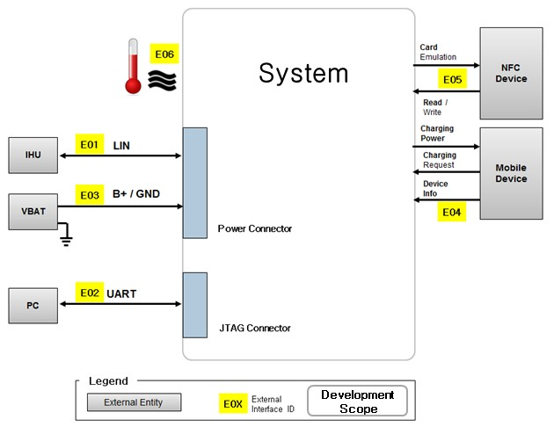
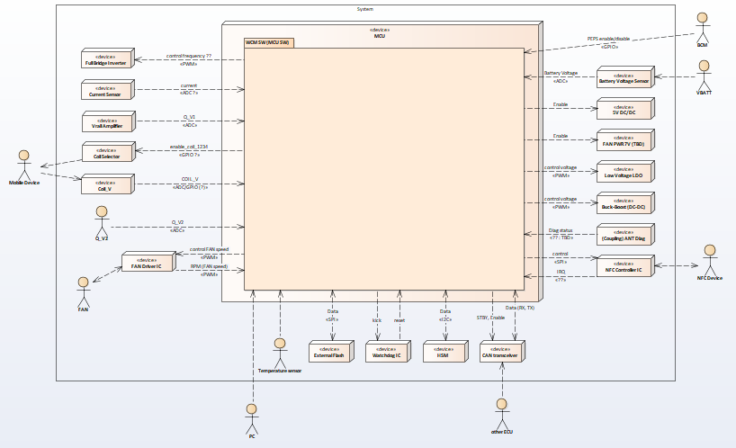
3. Requirement Definition Details 1) System/Software Scope Definition
Define system/software scope
The scope definition of the implementation target system/software includes the following.
[Define System/Software Context] Defines the boundary of the target system/software and identifies external objects that interact with people, systems, and environments
[Define System/Software Interface] Defines input/output contents and means for interaction between target system/software and external objects
[Define System/Software Feature/Function] Define the role of the target system/software
[Define System/Software Context]
It defines the scope of the target system/software to be implemented and describes the external environment that interacts with the target system/software.
Identify target system/software boundaries
Identify external objects outside the target system/software boundary
Define the interaction (interface) between the target system/software and external objects
System Context Example
Software Context Example

Slide 8
3. Requirement Definition Details 1) System/Software Scope Definition
[Define System/Software Interface]
Briefly describe the input/output interface that interacts with the target system/software and external objects.
interface name (or ID)
Interaction target (Source/Target)
I/O contentsi
nterface type, etc.
System Interface: Describes mainly the system level physical interface.
SW interface: Describes the message-level interface corresponding to the SW function.
[Define System/Software Feature/Function]
Describes the main functions performed by the system/software to be implemented.
[System requirements vs Software requirements]
System requirements are written to include all customer requirements based on system context.
Describes the system's response/action to the system's actors or external entities.
Recognizes the system as a back box. (Since SysAD does not exist yet, it is assumed that the system structure is not known, or if necessary, it is expressed as a function block (xy function) or use case.)
When describing system requirements, use ‘system’ or ‘xy system’ as the subject.
Software requirements are written by specifying the contents of SysRS based on the software context.
It describes the response/action of the SW to the actors or external entities of the system and the entities inside the system.
SW recognizes it as a black box. (As there is no SAD yet, it is assumed that the SW structure is unknown, or if necessary, it is expressed as a function block (xy function) or use case)
When describing SW requirements, use ‘SW’ or the SW element identifier (eg, MCU_SW) identified in SysAD as the subject.

Slide 9
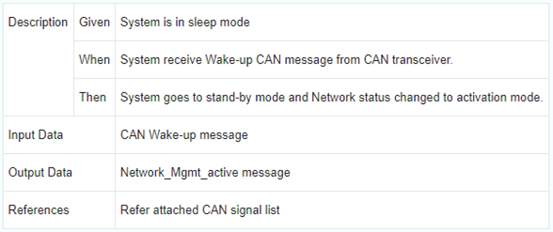
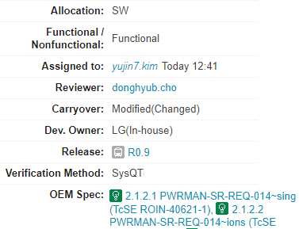
3. Requirement Definition Details 1) System/Software Scope Definition
[Technical feasibility of System requirement and Software requirement]
The system/software requirements are specified so that the results of analyzing the feasibility of implementation can be verified.
The feasibility analysis includes the following.
Development Schedule
human resources
Developer
technical competency
Verification Criteria and Verification Method
The feasibility analysis content can be included in the meaning of the Verification Criteria when writing the requirements specification.
Items such as development schedule, human resources, development subject, technical competency and verification method can be managed as field attributes of ALM as follows.
Example of requirements specification with feasibility analysis applied (using codeBeamer)
Specifications including verification criteria
Specification Item Field Attributes
Preconditions for a function to be performed
event that triggers the action
Process of function and expected result
human resources
technical competency
Data required for the processing of functions
developer
Development Schedule
Result data of the performance of the function
Verification method
References for function operation

Slide 10
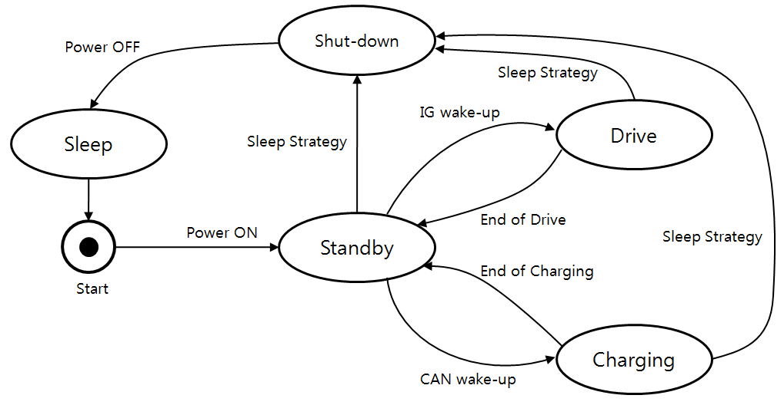
3. Requirement Definition Details 2) Functional Requirements Definition
Defining system/software functional requirements
The functional definition of the system/software to be implemented includes the following.
[Analyze Operation Mode] Analyze operation mode and transition condition of system/software
[Analyze Operation Scenario] Analyze major operation scenarios by operation mode
[Define & Quantify Functional Requirements] Define functional requirements of system/software
[Analyze Operation Mode]
It defines the operating modes that the system/software can have, and analyzes the operating mode transition conditions and functions performed in each operating mode. This can be expressed through a state machine..
Operation mode (or state): Defines operation modes such as On/Off, Standby, Run, Sleep, and Maintenance.
Functions performed in the operating mode (or state): Describes the functions performed in the operating mode.
Transition between operating modes: Defines an event that causes transition between operating modes..
An operation mode may have one or more Operation Scenarios.
Operation Mode Example
State Machine Diagram Example
System X includes eight operational modes; transitions between modes are specified in diagram D
System X transits from “Off-mode” to “Standby-mode” by the switch-on event
Every operational mode can be interrupted by the switch-off command; then system X transits to the “Off-mode”
In “M-mode” system X satisfies functional requirements of section S of document D

Slide 11
3. Requirement Definition Details 2) Functional Requirements Definition
[Analyze Operation Scenario]
Analyze key operational scenarios, including interactions between target systems/software and external objects. An operational scenario can be described as a series of or parallel system functions/operations. The operation scenario may be expressed in text form or in the form of a diagram (activity diagram, sequence diagram, etc.).
Operation Scenario Definition Example
In “Run-mode” system X performs following main actions: initiate preparation, select appropriate protocol, analysis samples, bind NA, purify NA, Elute NA, close the run. In parallel, wastes are processed and tracking of inputs are managed.
[Define & Quantify Functional Requirements]
Describes the functions or actions that the system/software must perform to accomplish a given task.
It can be derived through mission and operational scenario analysis.
In addition, the performance conditions that must be satisfied when performing a function or action are expressed as quantitatively as possible.
For the consistency of the specification, the terms used should be defined and used as much as possible in the glossary.
Requirements can be expressed in a number of ways..
Natural language: Has advantages in readability, expressiveness, scalability, and traceability, but has a disadvantage in terms of accuracy
Formal and Structural: High accuracy and easy to verify, but poor readability and requires a lot of effort to write
Schematic: It is possible to organize various data in an integrated manner, but it is inconvenient to manage a large number of requirements
In many cases, natural language is used, and the following standard text is used to compensate for the shortcomings.

Slide 12
3. Requirement Definition Details 2) Functional Requirements Definition
Basic form: [Subject] + [Action] + [Object]
Subject is the target system/software
Function-related action
When Object is information-type: process, send, receive, store/record, update, retrieve
When Object is energy-type: transform, power-up, power-down, transport, accumulate, liberate
Control action
start, stop, resume, enable, disable
Object is input/output that interacts with external objects
Input/output to interact with external objects: in/out from Sensor, Actuator, Communication, …I/O between internal functions
Example of functional requirements in basic form
The system shall deserialize received video data
The system shall display pending customer invoices in ascending order

Slide 13
3. Requirement Definition Details 2) Functional Requirements Definition
Complex form: [Trigger event] + [Pre-condition], [Subject] + [Action] + [Object] + [Performance condition]
Subject, Action, and Object follow the content of the basic form
Trigger event: A condition that triggers an action
Events such as the occurrence of an interrupt execution cycle
Pre-condition: A condition that must be supplemented when a trigger condition occurs
System/software status, etc.
Performance condition: Quantitative performance condition that must be satisfied when performing an action
Rates, Velocities, Resolution, Distance, etc.
Examples of functional requirements in complex form
When signal x is received, the system shall set the signal x received bit within 2 seconds
At sea state 1, the Radar System shall detect targets at ranges out to 100 nautical miles

Slide 14
3. Requirement Definition Details 3) Interface Requirements Definition
Define interface requirements
The definition of the interface requirements of the system/software to be implemented includes the following.
[Define Functional Interface Requirements] Define input/output information and means for interface with external system
[Define Communication Interface Requirements] Detailed specification of communication protocol
[Define HMI Requirements] Detailed specification of complex user interfaces
[Define Functional Interface Requirements]
It defines how the system/software interacts with related external systems. It defines an interface with an external system that requires interaction, and defines input/output information and interface means sent and received through the interface.
system interface
Input information: power, information collected from sensors, information from other systems, etc.
Output information: dynamometer control information, power provided by the dynamometer, information provided to other systems, etc.
Interface means: Hard-wired interface, vehicle network communication (CAN, MOST, LIN, FlexRay, etc.)
software interface
Input information: information collected from sensors, information from other systems, hardware control information, etc.
Output information: dynamometer control information, information provided to other systems, hardware control information, etc.
Interface means: Register, ADC, PWM, etc.
It also defines transmission/reception functions for input/output information.
The detailed protocol related to the communication interface and the detailed screen requirements related to the user interface are defined separately.

Slide 15
3. Requirement Definition Details 3) Interface Requirements Definition
[Define Communication Interface Requirements]
A detailed specification is defined separately for the protocol related to the communication interface. If a separate specification exists, it may be referred to.
Network Communication Protocol: Specification technology for message composition used in communication through CAN, LIN, MOST, FlexRay, etc.
Serial Communication Protocol: Specification technology for register configuration for communication through SPI, I2C, etc.
CAN RX message specification example
No | Signal Name | Signal Description | Signal Byte No. | Signal Bit No. | Signal Length | Signal Default
1 | ISw_Stat | Ignition switch state | 2 | 4 | 3 | 07H
2 | DidA_ExtTest_Pres | DidA external tester present | 5 | 0 | 1 | 00H
3 | TGW_Rout_Stat | TGW routing status | 1 | 0 | 2 | 00H
4 | PN14_SupBat_Volt | Supply battery voltage | 1 | 0 | 8 | FFH
5 | PN14_SupBat_Curr | Supply battery current | 2 | 0 | 11 | 7FFH
6 | PN14_SupBatCutSw_Stat | Supply battery cutoff switch state | 3 | 3 | 2 | 00H
7 | PN14_TransMd_Stat | Powernet transport mode status | 4 | 4 | 2 | 03H
SPI Register configuration example
No | Register Name | Description | offset | Initial Value | R/W
1 | fpgaID0 | FPGA image ID0 | 0x0000 | TBD | RO
2 | fpgaID1 | FPGA image ID1 | 0x0002 | TBD | RO
3 | lockStatus | Signal Lock Status | 0x0004 | 0xXXXX | RO
4 | blockEnable | HUS/ICS Block Enable | 0x0006 | 0x0000 | RW
6 | interruptEnable | Interrupt Enable | 0x000a | 0x0000 | RW
7 | interruptStatus | Interrupt Status | 0x000c | 0x0000 | RO

Slide 16
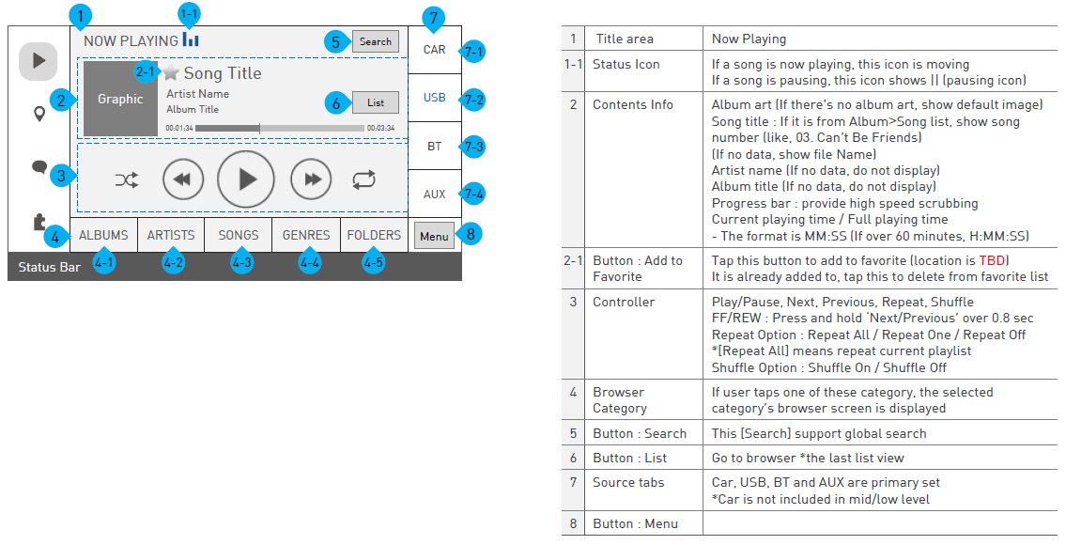
3. Requirement Definition Details 3) Interface Requirements Definition
[Define HMI Requirements]
Define detailed specifications for complex user interfaces, such as screens that interact with users. If a separate specification exists, it may be referred to.
HMI Specification Example

Slide 17
3. Requirement Definition Details 4) Safety Requirements Definition
안전 요구사항 정의
안전 요구사항은 대상 시스템/소프트웨어 기능의 오동작으로 인해 발생할 수 있는 위험을 예방하거나 감소시키는 방안에 대한 것으로 다음 사항을 포함한다.
[Devise Safety Mechanisms] 시스템/소프트웨어가 수행할 안전 메커니즘 도출
[Define Safety Requirements] 도출된 안전 메커니즘을 기반으로 안전 요구사항 기술
[Devise Safety Mechanisms]
안전 메커니즘(safety mechanisms)은 시스템/소프트웨어가 안전 상태에 유지하거나 도달하기 위해 관련 결함을 검출하고, 사람에게 위해가 가지 않도록 조치하는 구체적 방안을 말한다. 안전 메커니즘 도출을 위해서는 다음을 고려해야 한다.
시스템 자체에서 발생한 고장의 감지 및 표시, 제어하기 위한 안전 메커니즘
시스템과 관련된 외부 장치에서 발생한 고장의 감지 및 표시, 제어하기 위한 안전 메커니즘
e.g. 1) Random HW Failure를 감지하기 위한 안전 메커니즘
“System element는 A/D 컨버터에서 고장이 발생 되었을 때 self-monitoring을 통해 감지되어야 한다.”
(self monitoring은 Test Pattern 기법 적용)
e.g. 2) Communication channel의 고장을 감지하기 위한 TSR
“System element는 안테나에서 wireless data를 수신하지 못하는 경우, 내부 안테나로 전환 할 수 있어야 한다.”
e.g. 1) Actuator의 고장을 감지하기 위한 안전 메커니즘
“System element는 contactor에서 고장이 발생 되었을 경우, output 출력의 모니터링(Contactor feedback status)을 통해
감지 되어야 한다.”

Slide 18
3. Requirement Definition Details 4) Safety Requirements Definition
A safety mechanism for maintaining or achieving a safe state of a system
Safety mechanism to provide warning and degradation to the driver
Safety mechanisms to prevent latent faults
e.g. 1) Safety mechanism for transition to safe state (including safe state, fault tolerance time interval)
“The System element must provide a warning message to the cluster within XXX ms when the system temperature is above XX.”
e.g. 2) Safety mechanisms to maintain a safe state
“The system element must be able to provide auxiliary power for XX when the power supply is interrupted.”
e.g.) TSR with Warning & Degradation
“In the event of an engine failure while driving, the system limits the vehicle speed to less than XXX Km, provides a warning alarm to the driver and a warning message to the cluster, and records the failure information in the DTC. “
※ Degradation: Restricting the function or limiting the performance
e.g.) TSR for Dual Point Fault Prevention
“The system must perform a self-test to detect ROM/RAM faults during power up. “
“When a failure occurs in EDC (Error Detection and Correction) logic, the SM of the flash memory must detect an error through a test (pre-drive check).
※ In general, multiple-point fault mainly means dual-point fault.

Slide 19
3. Requirement Definition Details 4) Safety Requirements Definition
[Define Safety Requirements]
Describe the safety requirements based on the derived safety mechanism. Safety requirements are described in natural language, and the following standard text is used to compensate for the shortcomings.
Fault Detection & Monitoring Safety Requirements
[subject] shall detect [detected target] [time constraint]
[subject] shall monitor [monitored target] [time constraint]
e.g. 1) Fault Detection focus
“The engine control unit shall detect short-circuits and open-circuits at the throttle valve drive within xx ms”
e.g. 2) Fault Monitoring focus
“ XXX block shall monitor the XXX control output variables using plausibility of the values against min. and max. limits.”
Fault Reaction Safety Requirements
[Trigger event], [subject] shall perform [reacted action] [time constraint]
e.g.) Fault reaction
“If there is non-plausibility between nominal value 1 and nominal value 2 of the pedal valve sensor, then the system shall
be switched to Limp Home Mode with minimum value of PVS1 and PVS2.”
“In case of negative matching between both sensor, the initiator will be not be activated”

Slide 20
3. Requirement Definition Details 5) Quality Attribute Definition
Quality Attribute Definition
Quality attributes are distinguished from the functional requirements described for specific operation of the target system/software, and present criteria for evaluating whether the operation of the system/software is satisfactory. Also called non-functional requirements, they are attributes related to the system/software as a whole or specific aspects rather than specific functions. (Performance conditions related to individual functions are described together when defining functional requirements.)
Sentence form: “System shall be <requirements>” (vs. Functional requirements sentence form: “System shall do <requirements>”)
The main quality attributes are: (According to ISO/IEC 25010-2011 Quality Model)
performance efficiency
Reliability
Maintainability
Compatibility
Usability, Security, Portability
[performance efficiency]
Appropriate use of resources and appropriate degree of reaction time
Time Responsiveness: Response and processing time (speed) and throughput rate when performing a function
Resource Utilization: When performing a function, the type of resource used (memory, etc.) and the maximum allowable amount
Capacity: Maximum limit of product parameters (storable data capacity, backup capacity, communication bandwidth, number of simultaneous processing events, etc.)
e.g.) Efficiency-related quality attributes
Measurement error according to distance measurement accuracy should be within <15% at 50~250m.The forward obstacle detection delay time should be at most 200 ms at 250-350 m.
When data generated in system A is transmitted to system B through CAN communication, if system B does not receive a signal for 1000 ms, a transmission failure result must be generated.
The processing speed of the system must be at least 30 FPS (Frames per second).

Slide 21
3. Requirement Definition Details 5) Quality Attribute Definition
[reliability]
The ability to perform its intended functions and tasks without defects in a prescribed environment.
Availability: The degree to which users can actually use and access at the desired time/time.
Fault tolerance: the degree to which a person can overcome (endure) a failure and perform an intended operation
Recoverability: The degree to which data can be recovered and returned to a normal state in the event of a failure.
MTFF (mean time to first failure): time until first failure occurs
MTBF (mean time between failure): The time until the next failure occurs after recovery from failure
Degree of use and maintenance of essential functions in a state of disability
e.g.) Reliability-related quality attributes
The system should be running at 80% availability (the system is not down).If operation is impossible due to system O/S Kernel Panic, a restart such as system RESET should be performed, and this should be done with the WDT (Watch Dog Timer) function inside or outside the chip.
The MTBF (Mean-Time-Between-Failures) of the brake system should be 50000h.The life of the part should be 10 years and 160,000 km. [Applies to all system parts]If the ECU input voltage is out of the normal range, the SOL power must be turned off.
Watch Dog detects XXX every 100ms and restarts the thread when a fault occurs.
System X withstands sinusoidal vibrations as specified in the standard S.
System X withstands temperature between -60°C and +140°C; maximum temperature gradient is 4°C per second. The running of the system between 120°C and 140°C is limited to 8 minutes.
System X withstands electromagnetic fields as specified in standard S

Slide 22
3. Requirement Definition Details 5) Quality Attribute Definition
[maintainability]
Ease of system/software modifications and changes
Modularity: the degree to which individual components (components, modules) with minimal impact are composed, strategy
Reusability: The degree and strategy of common code reuse and open source reuse so that it can be used for other projects and other models.
Correctability: When a program change is required, it is easy to identify the cause and identify the corrective part and take action.
Testability: The degree of functionality provided for testing.
e.g.) Quality attributes related to maintainability
System shall provide JTAG for S/W maintainability, as following function. . Flash fusing, Memory reading,
System design shall exhibit all of the following properties by use of the principles : . Hierarchical design, Modular Design
[compatibility]
Interoperability with other systems, interworking ability
Interoperability: The degree to which two or more systems, products, or components can exchange information or use the exchanged information without problems.
Coexistence: The degree to which the required function is effectively performed while sharing the environment and resources without adversely affecting other software.
e.g.) Compatibility-related quality attributes
Data must be transmitted without loss through the communication protocol (RS233C).
Exported/imported data should be delivered without loss.
Compatibility with communication protocols, web browsers, USB standards, etc.

Slide 23
3. Requirement Definition Details 6) Constraints, Laws and Standards Definition
Constraints, standards and statutory definitions
Constraints are conditions that must be complied with to perform system/software design and implementation (solution), and are items that restrict the selection of development activities. Constraints are often imposed by compatibility, quality objectives, and standards and laws to be followed.
Implementation constraints: Solutions that are stated to be used or not. Reusable components, the use of certain technologies or products, etc.
Physical constraints: Restrictions on size, weight, color, space, etc.
- Regulation constraints: Regulations or laws you must comply with
e.g.) Implementation constraints
X technology is used to implement F function of the system
e.g.) Physical constraints
The physical implemented system is a bench-top instrument which does not exceed a volume of X m³ and a surface of Y m²
When mounted on the engine, the actuator has no external cavities that may retain liquids
e.g.) Regulation constraints
System X demonstrates electrical safety and EMC with the approval of regulatory R
Standard constraints: standards to be applied
e.g.) Standard constraints
The connector of system X are compliant with S standard

Slide 24
3. Requirement Definition Details 7) Requirement Structure and Refinement
Requirement structuring and refinement
Requirements structuring and refinement activities include:
[Organize requirements]
Divide the types of requirements and structure them accordingly. e.g.) Examples of requirement types – functional classification, system/software structure (design/implementation module), etc
Prioritize requirements in consideration of stakeholder needs and dependencies between requirements.
In this process, requirements are segmented and refined.
Example of structuring requirements
Input processing – control functions – classification in terms of output processing
: I/O processing is structured based on the target (system subcomponent) item
: The control function is structured based on the processing algorithm, all action judgment functions, etc.
1. Functional Requirements
1.1 Power (Input)
- req. 1
- req. 2
1.2 FPGA (Input)
- req. XX
- req. XX
…
1.X Dimming (algorithm)
…
1.X Diagnostic (Output)
1.X BLU (Output)
Input
Input processing function
control function
Output processing function
e.g.) | signal detection
 | signal detection (algorithm)
 | - operation mode judgment
 | - output control
System
Output
*’#Reference 2. 'Use case analysis method' is a good method of structuring requirements through actor/event, basic flow, alternative flow, exception, etc.

Slide 25
3. Requirement Definition Details 7) Requirement Structure and Refinement
[Assign a formal identifier and attributes]
A unique ID is assigned to use and manage requirements.
Defines the attributes necessary for the utilization and management of requirements. Requirement attributes can be determined and used according to the project..
Requirement attribute (example): When using the requirements management tool (DOORS)
Sub-Trackable (Req?): Whether to be traced with a sub-requirement or design.
Traceability to parent requirements (management tool link): Reference to parent requirements
Whether to be verified (Ver?): Whether to be verified through testing activities
Verification method (VM): SyT, Syt(Dev*), SwT, SwT(Dev*), Review, Analysis, etc.
Verification Criteria (VC): Criteria for judging whether verification by verification method has passed or not
Priority: The implementation priority of the requirement. May be described as the time of system/software release
HW/SW Allocation of Requirements (HW/SW): Assignment of which technology (HW, SW or both) the implementation of the requirements will be implemented
Applied variants (Variants): If the system/software has a variant model, it specifies the variant model to which the requirements apply.
ASIL Assignment to Requirements (ASIL): If there are functional safety requirements, the ASIL rating assigned to the requirements.
Reference information (Info): Information that is not a requirement but should be referenced, such as relevant rationale, design/implementation notes, etc
*Dev : Development team verification items that are difficult for third-party verification due to test environment or test conditions

Slide 26
3. Requirement Definition Details 7) Requirement Structure and Refinement
Application Criteria for Requirement Attributes
he criteria for applying the properties for each requirement document are as follows. The black font is basic, and the blue font is an example of the classification added by project.
For each document, ● is the basic application target, and O can be applied as needed.
Attribute | Status | Type | Type | Feature | Sys Element | Component | Allocation | Priority | Risk | Owner | VM | VC | Testability | Status of OEM | Comments of OEM | Status of LG | Comments of LG | Source | Date of Agreed
Item | Draft | Heading | Heading | Image Capture |  |  | HW |  |  |  | SyT |  |  | Draft |  | Draft |  | OEM
 | Fixed | Req | IFR | Basic Function |  |  | ME |  |  |  | SyIT |  |  | Accepted |  | Agreed |  | LGE
 | Rejected |  | FR | Head Tracking |  |  | SW |  |  |  | SwT |  |  | Rejected |  | Rejected
 | Deleted |  | QAR | Eye Lid Tracking |  |  | HW-SW |  |  |  | SwIT |  |  | Deleted |  | Deleted
 | TBD |  | DCR | Driver Behavior |  |  | HW-ME |  |  |  | SyT(Dev) |  |  | TBD |  | TBD
 | N/A | Information | Information | Power |  |  | Display |  |  |  | SwT(Dev) |  |  | N/A |  | N/A
 | Duplicated |  |  | Diagnosis |  |  | Optics |  |  |  | Simulation
 |  |  |  | Watchdog |  |  | Test |  |  |  | Review
 |  |  |  | Telltale |  |  | Production |  |  |  | Demo
CRS |  | ● |  | ● |  |  | O |  | O | ● |  |  |  | ● | ● | ● | ● | ● | ●
SyRS | ● |  | ● | ● | ● |  | ● | ● | O | ● | ● | ● | O |  |  |  |  | O
SRS | ● |  | ● | ● | ● | ● |  | ● | O | ● | ● | ● | O
비고 | Duplicatedmeans deletion due to duplication |  |  | SW Classification

Slide 27
3. Requirement Definition Details 8) Requirements verification
Requirements Verification
Requirements are verified against the following criteria. If problems related to requirements (eg, ambiguity, conflict, TBD, etc.) are found, they are dealt with according to the issue management process.
Attribute | Individual Requirements Verification Criteria
Necessary | The requirement defines an essential capability, characteristic, constraint, and/or quality factor. If it is removed or deleted, a deficiency will exist, which cannot be fulfilled by other capabilities of the product or process.
Unambiguous | The requirement is stated in such a way so that it can be interpreted in only one way. The requirement is stated simply and is easy to understand
Complete | The stated requirement needs no further amplification because it is measurable and sufficiently describes the capability and characteristics to meet the stakeholder's need
Consistent | The requirement is free of conflicts with other requirements
Verifiable | The requirement has the means to prove that the system satisfies the specified requirement. Evidence may be collected that proves that the system can satisfy the specified requirement. Verifiability is enhanced when the requirement is measurable
Traceable | The requirement is upwards traceable to specific documented stakeholder statement(s) of need, higher tier requirement, or other source (e.g., a trade or design study). The requirement is also downwards traceable to the specific requirements in the lower tier requirements specification or other system definition artefacts. That is, all parent-child relationships for the requirement are identified in tracing such that the requirement traces to its source and implementation.
Feasible | The requirement is technically achievable, does not require major technology advances, and fits within system constraints (e.g., cost, schedule, technical, legal, regulatory) with acceptable risk
Attribute | Full Requirements Verification Criteria
Complete | The set of requirements needs no further amplification because it contains everything pertinent to the definition of the system or system element being specified. In addition, the set contains no To Be Defined (TBD), To Be Specified (TBS), or To Be Resolved (TBR) clauses. Resolution of the TBx designations may be iterative and there is an acceptable timeframe for TBx items, determined by risks and dependencies.
Consistent | The set of requirements does not have individual requirements which are contradictory. Requirements are not duplicated. The same term is used for the same item in all requirements.
Affordable | The complete set of requirements can be satisfied by a solution that is obtainable/feasible within life cycle constraints (e.g., cost, schedule, technical, legal, regulatory).
Bounded | The set of requirements maintains the identified scope for the intended solution without increasing beyond what is needed to satisfy user needs

Slide 28
3. Requirement Definition Details 9) Evaluate the impact on the operating environment
Impact assessment on system operating environment (ASPICE target)
Identifies the external interface and operating environment of the system, identifies risk through impact assessment, and updates SysRS to improve it.
It should be written as a separate document from SysRS and baselined after approval.
It is updated when the system operating environment changes.
The environmental evaluation items are based on the examples below, but there is no limitation thereto.
Impact Assessment Table on System Operating Environment
IF_ID | Interface | External Entity | Possible Impact (Risk) | Measurements | Risk* | SysRS_ID
E01 | CAN | IC | Communication error | CRC check | NA
E02
..
EN_ID | Environment
V01 | Temperature
V02 | Humidity
V03 | EMC/EMI
V04 | Mounting
V05 | Noise/Vibration/Harshness
V06 | Memory
Date/Location:
attendees :
*Risk : Expected results from application of countermeasures (NA, High, Medium, Low)

Slide 29
3. Requirement Definition Details 9) Evaluate the impact on the operating environment
Impact assessment on SW operating environment (ASPICE target)
Identify the external interface (HIS) and operating environment of SW, identify risks through impact evaluation, and update SRS to improve them.
It should be prepared as a separate document from the SRS and baselined after approval.
It is updated when the system operating environment changes.
For environmental evaluation items, refer to the example below, but there is no limitation thereto.
SW Operation Environment Impact Assessment Table
IF_ID | SW Element | Sys Element | Possible Impact (Risk) | Measurements | Risk* | SRS_ID
I01 SPI | MCU_SW | C02 CAM | Communication error | check register status | NA
I02
..
EN_ID | Environment
V01 | OS (OSEK)
V02 | reusable module
V03 | Outsourcing development module
V04 | purchase module
V05
V06
Date/Location:
attendees :
*Risk : Expected results from application of countermeasures (NA, High, Medium, Low)

Slide 30
# Reference 1. Criteria for writing Verification Criteria
Verification Criteria is written in the following two combinations.
Verification Methods
Multiple selection of Verification Methods presented below
Verification Criteria
Briefly describe the criteria for verifying Req. according to Verification Methods
Verification Methods
Test (SysT, SysIT, SWT, SWIT, SWUT, etc.)
Requirement documents such as SysRS, SRS, etc. should describe one or more Verification Methods including Test.
For items that cannot be tested among SysRS and SRS items, only other verification methods can be described..
In the case of functional tests, only the test steps need to be explicitly described.
Describes the test steps other than the functional
Stress Test, Performance Test, Diagnostic Test, Network Test, etc.
Review (Visual Inspection-actual confirmation, Code Review, Design Review, Document Review, etc.)
The main verification methods of design documents such as SysAD and SAD can be Review
Analysis (FMEA, Static Analysis, SW Profiling, Resource Measurement, etc.)
Demonstration

Slide 31
# Reference 1. Criteria for writing Verification Criteria
Write Test Case and Review Check List according to Verification Methods
When Verification Method is ‘Test’
A test case must be written to verify the relevant Req.
When Verification Method is ‘Review’
A Review Checklist must be prepared to verify the relevant Req.
If you do not use the Review Checklist, the review result must include the review of the Req.
If the Req. is clearly described, only the Verification Method should be described and the Verification Criteria may be omitted.
Req. Only when the range of the input value and the output value corresponding to the input value are clearly described in the description
That is, it means that the person in charge can write a test case only by looking at the Req.

Slide 32
# Reference 1. Criteria for writing Verification Criteria
SRD(SysRS) Example
Req.
When Power supply is between 6V and 16V, Controller shall work normally.
VC
Test (SyST) Check whether it operates normally within the defined power range
Req.
When receiving diag command from HU, Controller shall provide the fault code and information data to HU.
VC
Test (SyST – Diagnostic Test) and Simulation (CAN) CAN을 통해 입력된 값에 해당하는 information data가 출력되는지 확인 해당 Command에 대한 진단코드(DTC)가 작성되어 있는지 확인 (Diagnostic Spec 참고)
Req.
ALS shall be able to measure illumination ranged with 1 to 10klx
VC
Test (SyST) 정의된 입력 범위에 대한 측정 값이 출력되는지 확인

Slide 33
# Reference 1. Criteria for writing Verification Criteria
SRS Example
Req.
FPGA shall process test pattern command as following sequences. ~~
VC
Test (SWT)
Check that the corresponding Register value is set for all TestPattern that can be input (refer to Register Map)
Req.
Dimming shall implement dimming algorithm to adjust brightness of backlight based on following elements.
- ALS, Day/Night, Temperature, Offset of display brightness
VC
Test (SWT), Code Review
Code review on the algorithm, check whether the algorithm works normally during testing
Req.
When receiving the notification from BLU about the LED backlight defect, DiagDtc shall store the relevant DTC record in EEPROM - DTC : 0x99C400 ( Backlight Head Unit Screen defect )
VC
Test (SWT)
Check if the diagnostic code (DTC) corresponding to the notification is saved

Slide 34
# Reference 1. Criteria for writing Verification Criteria
Main Verification Methods by Document Item
- Check ‘whether or not VC is written’ by the contents, and write VC only for items with ‘o’ in ‘Req?’ of the View in the Requirements Management Tool (Doors) in the relevant details.

Slide 35
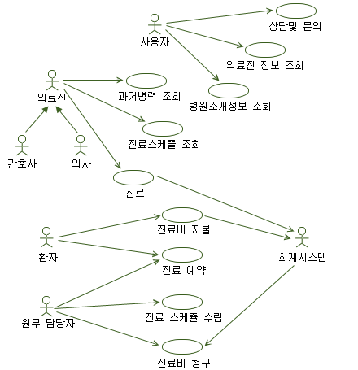
# Reference 2. How to analyze use cases 1) Overview
Use case is an object-oriented method to analyze/define the functional requirements of system/SW.
Overview
A use case is a well organized set of requirements.
Visualize the function of the system in units of use cases. (use case diagram)It is easy to understand the entire function and communicate with stakeholders through the use case diagram.
It defines the interaction between the actor and the use case of the system. (use case description)It is applicable to most system/SW requirements that operate interactively with actors.
It is easy to switch to object-oriented design through use case description.
It is easy for task assignment, schedule management, and distribution management by use case unit.
This is a general functional requirement analysis method used globally.
Actor
Existing outside the system and interacting with it
A person or something that the system asks for a service.
A person or something that receives information or services provided by a system.
A hardware device or other system that communicates with the system.
Ex) Payer, buyer, payment system, delivery system, temperature sensor, alarm, CCD cam
< use case diagram example>
Use Case
Services or functions provided by the system
One UC consists of a series of procedures / steps to achieve a unique goal.
Perform desired processing or provide desired information in response to an actor's request (event)Identification of the information required by the actor or the behavior of the actor interacting with the system (noun+ verb, verb + noun in English)
Ex) Purchase approval, product information inquiry, medical expense calculation, alarm sound output
A use case can be decomposed into sub-use cases. (Keep similar levels of abstraction for each sub-level)

Slide 36




# Reference 2. How to analyze use cases- 2) Use case diagram
A use case diagram graphically represents the actor and use case relationship. (not actual requirements)
A use case must have a relationship with one or more actors or one or more other use cases.
Relationships are defined between actor-usecase, actor-actor, and usecase-usecase.
There should be no isolated use cases (there are no use cases that are not directly or indirectly related to an actor).
By clarifying what the use case interacts with, the SW can be understood better.
Communicates (Association) | Generalization | Include (call relationship) | Extend (optional relationship)
Relationships between actors and use cases General Interaction Relationships - Actors have a specific purpose of use and interact with a use case. Actors request or receive services, and use cases provide services or information. | Actors and actors, and the relationship between use cases and use cases the relationship between the universal and the concrete Has the concept of inheritance (when subdividing a parent UC) | Use cases and use case relationships Request to perform a service for another use case The service requested to be performed must be performed A use case that is requested to perform is an entity with a common service (Shared Service). | Use cases and use case relationships Same as Include, but use cases that request execution may or may not request execution depending on conditions.
<<include>>
로그인
사용자인증
고객
목록조회
<<extend>>
고객 상세
정보 조회
<<Include>>
계좌이체

Slide 37
# Reference 2. How to analyze use cases- 3) Use case description (1/4)
The use case description describes the details for each use case identified in the use case diagram. (become the actual requirements)
Written items (composed of the following items, some additions/changes are possible.
UC_ID: It expresses the level and name of the use case together. Yes, UC1.1 Outgoing Call
Brief Description: Briefly explain in one sentence to reveal the goal of the use case.
Initiating Actor/Event: Fill in the actors and signals/requests provided by the actors.
Secondary actor/event : Actor /event involved during UC execution (optional)Precondition / Post
condition: Describes the system state before/after the use case is activated.
Basic Flow: Describe the basic success processing flow in which the goal of UC is achieved.
Alternative Flow: Success processing flow according to condition. Misbehaving primary actor (eg, password error)Exceptions: Describes the processing flow for exceptions (failures).
Inactive primary actor (timeout waiting for password input)
Handling verification failure (invalid account number)
Inappropriate half or no response of supporting actors (response usually timed out)
System internal error / communication error / insufficient resources
Unexpected abnormal internal error (corrupted transaction record)system response time over
Relegated UCs: Use case list in Include/Extend relationship (optional)
Special Requirements: Requirements that are difficult to fill out according to other flows
Information: Other notes.
UC_ID | UC1 Call
Brief Description
Initiating Actor/Event
Preconditions
Post-conditions
Basic Flow
1. 2. … 3. …
Alternative Flow
3a. Alternative 조건: 3a.1 … 3a.2 …
Exceptions
2a. Exceotion 조건 : 2a.1 …
Special req.
Information
<Use case description Form>

Slide 38
# Reference 2. How to analyze use cases- 3) Use case description (2/4)
How to write a Flow
Clarify the actor (system/SW Element).Write in simple and complete present tense. (You don't need to use shall or should for simple sentences.)
Describes what the system should do in the sequence of interactions with actors.
Avoid mentioning terms from a physical implementation point of view (what to do point of view).
System/SW is recognized as a black box from the system/SW context point of view.
Avoid describing overly abstract (business/systems level) or overly detailed flows (coding level).
Size of use case: about one span (8-12 steps for basic flow)
Item number in Flow
The item number of Basic Flow is as in 1. 2.The item number of Alternative/Exceptions
Flow indicates the branch point based on the basic flow and is described in the form of ‘X.a Condition: Action’.
E.g, if branching from 1. of Basic Flow, write it as follows.
1.a Range error: Return result as range over. (if action is one line)
If an action requires multiple steps, separate it from the Condition line and write the action line as follows.
1a range error:
1a.1 Set the state variable to range over
1a.2 Returns the result as range over.
traceability
To ensure that higher requirements (customer requirements or system requirements) are not omitted (fill in traceability above)
Any of the higher requirements that do not meet the level (eg implementation level content) are treated as Information or traceability linked to that design.
Requirement ID applies only to each flow (basic, alternative, exception) and special req.

Slide 39
# Reference 2. How to analyze use cases- 3) Use case description (3/4)
System requirements are written by detailing customer requirements based on System Context.
The following is an example of system requirements definition using use case description.
SyRS_ID | System Requirements | CRS_ID | Type | Allocation
 | UC_ID : UC1.1.1 Outgoing Call
 | Brief Description : The calling subscriber attempts a call and the call is transferred to the other station's subscriber.
 | Actor / Event : Subscriber / Pick up the handset
 | Preconditions : The line of the calling subscriber is normal.
Y.CAL_1 Y.CAL_2 Y.CAL_3 - - Y.CAL_4 Y.CAL_5 Y.CAL_6 | Basic Flow : When the user picks up the handset, the system establishes a dial tone. When the user presses the button, the system cancels the dial tone and receives the number. When the user dials the number, the system determines the destination and delivers the number to the other station's operator through the trunk. The called station establishes a ring to the called subscriber, and a ringback tone to the calling station. (Caller hears ringback tone) When the called party picks up the handset, the called station disconnects the ring and connects the call line. When the calling or called subscriber hangs up the handset, a busy tone is connected to the other side. If the subscriber hangs up the handset while listening to the busy tone, the system cancels the busy tone. The system sends the billing information to the billing center. |  | FR FR FR - - FR FR FR | HW-SW HW-SW HW-SW - - HW-SW HW-SW HW-SW
 | Postconditions : Normal
Y.CAL_7 Y.CAL_8 | Alternative Flow : 2a. The user does not press the button for more than 30 seconds: The system attaches a busy tone for 30 seconds and then cancels the call. 3a. Wrong number: Attach voice guidance to the caller and then go to Basic flow 3. |  | FR FR | HW-SW HW-SW
Y.CAL_9 | Exceptions : 3b. No Idle Trunk: A busy tone is applied to the caller for 30 seconds and then the call is terminated. |  | FR | HW-SW
Y.CAL_10 Y.CAL_11 | Special requirements : There is no charge for emergency calling numbers.The maximum number of digits is 17. |  | FR FR | SW SW

Slide 40
# Reference 2. How to analyze use cases- 3) Use case description (4/4)
SW requirements are written in detail based on SW context for requirements allocated to SW among system requirements.
The following is an example of SW requirement definition using use case description. Blue font is more detailed/refined content compared to SyRS.
SyRS_ID | Software Requirements | SyRS_ID | Type | Allocation
 | UC_ID : UC1.1.1 Outgoing Call
 | Brief Description : The calling subscriber attempts a call and the call is transferred to the other station's subscriber.
 | Actor / Event : Subscriber / Pick up the handset
 | Preconditions : The line of the calling subscriber is normal.
UC1.1.1_1 UC1.1.1_2 UC1.1.1_3 UC1.1.1_4 - - UC1.1.1_5 UC1.1.1_6 UC1.1.1_7 | Basic Flow : When the user picks up the handset, the system checks the subscription status by inquiring the subscriber number. If there is no abnormality, a dial tone is connected and a DTMF receiver is attached. When the user presses the button, the system cancels the dial tone and receives the number through the DTMF receiver. When the user finishes dialing the number, the system cancels the DTMF receiver and determines the destination through number translation. If the destination is not local, the system searches the idle trunk to secure the trunk and delivers the number to the neighboring station through the signaling link. The called station checks the status of the called subscriber and, if normal, connects the ring and connects the ring back tone to the calling station. (Caller hears ringback tone) When the called subscriber picks up the handset, the called station disconnects the ring, connects the call path, and sends the Connect signal to the calling station. When the calling or called subscriber hangs up the handset, a busy tone is connected to the other side and the Disconnect signal is delivered to the other station. If the subscriber hangs up the handset while listening to the busy tone, the system hangs up the busy tone and terminates the call. The system sends billing information to the billing center if it is not an emergency call. | Y.CAL_1 Y.CAL_2 Y.CAL_3 Y.CAL_3 - - Y.CAL_4 Y.CAL_5 Y.CAL_6 | FR FR FR FR - - FR FR FR | HW-SW HW-SW HW-SW SW - - HW-SW HW-SW HW-SW
 | Postconditions : Normal
UC1.1.1_8 UC1.1.1_9 | Alternative Flow : 2a. The user does not press the button for more than 30 seconds: The system attaches a busy tone for 30 seconds and then cancels the call. 3a. Wrong number: Attach voice guidance to the caller and then go to Basic flow 3.. |  | FR FR | HW-SW HW-SW
UC1.1.1_10 | Exceptions : 3b. No Idle Trunk: A busy tone is applied to the caller for 30 seconds and then the call is terminated. |  | FR | HW-SW
UC1.1.1_11 UC1.1.1_12 | Special requirements : There is no charge for emergency calling numbers. The maximum number of digits is 17. |  | FR FR | SW SW

Slide 41
End of Document

